Slide 1

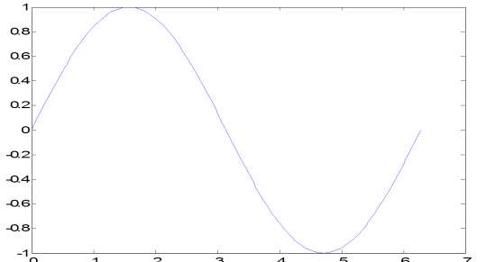
MATLAB lecture
Chapter Five: Graphics Assistant lecture: Jinan N. Shehab
Graphics
MATLAB can be used to produce a wide variety of plots thanks to its comprehensive graphics libraries. This chapter describes a few of the most important graphics functions and provides example of the most this function. You can get a list of MATLAB graphics commands by typing help graphics (for general graphics commands), help graph2d (for two-dimensional graphing), help graph3d (for three-dimensional graphing), or help specgraph (for specialized graphing commands).
5.1 Two-Dimensional Plots
5.1.1 Creating a Plot
The plot function has different forms, depending on the input arguments. If y is a vector, plot(y) produces a piecewise linear graph of the elements of y versus the index of the elements of y. If you specify two vectors as arguments, plot(x,y) produces a graph of y versus x. Use the colon operator to create a vector of x values ranging from 0 to 2 , compute the sine of these values, and plot the result.
>> x = 0:pi/100:2*pi;
>> y = sin(x);
>> plot(x,y)
>> t=[x,y] or >> t=[x,y]’
Example (2):- if we want to plot the angle from 0 to 360 versus the cos of these angle:
Solution:-
>> angle=[0:10:360];
>> cosine=cosd(angle);
>> table=[angle;cosine]';
>> plot(angle,cosine)
table =
0 1.0000
10.0000 | 0.9848
20.0000 | 0.9397
30.0000 | 0.8660
40.0000 | 0.7660
50.0000 | 0.6428
60.0000 | 0.5000
70.0000 | 0.3420
80.0000 | 0.1736
90.0000 | 0
100.0000 -0.1736
110.0000 -0.3420
120.0000 -0.5000
130.0000 -0.6428
140.0000 -0.7660
150.0000 -0.8660
160.0000 -0.9397
170.0000 -0.9848
180.0000 -1.0000
190.0000 -0.9848
200.0000 -0.9397
210.0000 -0.8660
220.0000 -0.7660
230.0000 -0.6428
240.0000 -0.5000
250.0000 -0.3420
260.0000 -0.1736
1
0.8
0.6
0.4
0.2
0
-0.2
270.0000 0
-0.4
280.0000 0.1736
290.0000 0.3420
300.0000 0.5000
310.0000 0.6428
320.0000 0.7660
330.0000 0.8660
340.0000 0.9397
350.0000 0.9848
-0.6
-0.8
-1
0
50
100
150
200
250
300
350
400
360.0000 1.0000

Slide 2
MATLAB lecture
Chapter Five: Graphics Assistant lecture: Jinan N. Shehab
And to label the axes and add a title( in command window or in M-file).
close all clear all
angle=[0:10:360];
cosine=cosd(angle); plot(angle,cosine)
xlabel('angle in degree from 0 to 360') ylabel('cos angle')
title('Plot of the Cosine function')
Plot of the Cosine function
1
0.8
0.6
0.4
cos angle
0.2
0
-0.2
-0.4
-0.6
-0.8
-1
0
50
100 150
200
250 300
350
400
angle in degree from 0 to 360
5.1.2 Multiple data sets in one plot
Multiple (x; y) pairs arguments create multiple graphs with a single call to plot. For example, these statements plot three related functions of x: y1 = 2 cos(x), y2 = cos(x), and
y3 = 0:5 × cos(x), in the interval 0 ≤ 𝑥≤ 2𝜋.
>>x = 0:pi/100:2*pi;
>> y1 = 2*cos(x);
>> y2 = cos(x);
>> y3 = 0.5*cos(x);
>> plot(x,y1,'--',x,y2,'-',x,y3,':')
>> xlabel('0 \leq x \leq 2\pi')
>> ylabel('Cosine functions')
>> legend('2*cos(x)','cos(x)','0.5*cos(x)')
2
1.5
2*cos(x) cos(x)
1
0.5*cos(x)
Cosine functions
0.5
0
-0.5
-1
-1.5
-2
0
1
2
3 4
0 ≤ x ≤ 2π
5
6
7
Note: the legend command provides an easy way to identify the individual plots.
H.W/ Complete example (2) and (1) and draw the cosine together with the angle and sine
5.1.3 Specifying line styles and colors
It is possible to specify color, line styles, and markers (such as plus signs or circles) when you plot your data using the plot command:
plot(x,y,'color_style_marker')
color_style_marker is a string containing from one to four characters (enclosed in single quotes) constructed from a color, a line style, and a marker type.
Symbol | Color | Symbol | Line Style | Symbol | Marker
‘k’ | Black | ‘—‘ | Solid | ‘+ ‘ | Plus sign

Slide 3
MATLAB lecture Chapter Five: Graphics
Assistant lecture: Jinan N. Shehab
‘r’ | Red | ‘- -‘ | Dashed | ‘o’ | Circle
‘c’ | Cyan | ‘:’ | Dotted | ‘*’ | Asterisk
‘m’ | Magenta | ‘-.’ | Dash-dot | ‘x’ | Cross
‘y’ | yellow | None | Noline | ‘.’ | Point
‘g’ | Green |  |  | ‘s’ | Square
‘b’ | Blue |  |  | ‘d’ | Diamond
‘w’ | White |  |  | ‘<’ | Left Triangle
If you specify a marker type, but not a line style, MATLAB creates the graph using only markers, but no line. For example,
plot(x,y1,'*')
Another example if we want add multi-figure together plot(x,y1,'--',x,y2,'-',x,y3,':')
H.W/ Plot two figure together gives (sin(x1) red with dashed line and sin(x2) green with dotted and cross marker)( don’t forget legend command).
5.1.4 Graphing Imaginary and Complex Data
When you pass complex values as arguments to plot, MATLAB ignores the imaginary part, except when you pass a single complex argument. For this special case, the command is a shortcut for a graph of the real part versus the imaginary part. Therefore,
Example: >> plot(3+3j,'o')
If z is acomplex vector or matrix, it will plot as:- Plot(real(Z), imag(Z))
Example:-
>>plot([0,3],[0,9],'-+')
9
8
7
6
5
4
3
2
1
0
0 0.5 1 1.5 2 2.5
3
Example:- plot the function y=e^{ix} over the interval [0,2𝝅] with increment ^{𝝅}
Solution:->> plot([0,3],[0,9],'-+')
>> x=[0:pi/10:2*pi];
>> y=exp(x*i);
>> table=[x;y]'
>> plot(y,'o-')
>> axis equal
1
��
0.8
0.6
0.4
0.2
0
-0.2
-0.4
-0.6
-0.8
-1
-1
-0.5
0
0.5
1

Slide 4
MATLAB lecture
Chapter Five: Graphics Assistant lecture: Jinan N. Shehab
After running the program it will draws a 20-sided polygon with little circles at the vertices. The command axis equal, makes the individual tick mark increments on x- and y-axes the same length which makes this plot more circular in appearance.
Some useful function and command which are used in plot function:-
Command | Purpose
plot | draw two-dimensional graphs
xlabel, ylabel, zlabel | define axis labels
title | define graph title
Axis [xmin, xmax], axis auto, axis square ,axis equal, axis on, axis off | To specify the axis limit , or automatic limit selection, or x &y same size, make x visible or invisible.
legend | show labels for plot lines
Text, gtext(‘any text’) | place text at selected locations
grid | turns grid lines on or off
Hold on, hold off | To add new graph to existing one, to terminate the adding graph
figure | Open new figure window if there are no figure windows already on the screen
Grid on, grid off | Turn the grid lines on , and off
Example:- plot the functions y1=e^{ix} and y2= sin (2x) over the interval [0,2𝝅] with increment
𝝅
��
,( first y only and second x with y).
Solution:-
>>x=[0:pi/10:2*pi];
>> y1=exp(x*i);
>> figure(1)
>> plot(y1,'-+')
>> y2=sin(2*x);
>> figure(2)
>> plot(y2,'-o')
>> axis square
>> axis equal
1
0.8
0.6
0.4
0.2
0
-0.2
-0.4
-0.6
-0.8
-1
-1 -0.8 -0.6 -0.4 -0.2
0 0.2 0.4 0.6 0.8
1

Slide 5
MATLAB lecture Chapter Five: Graphics
Assistant lecture: Jinan N. Shehab
>> figure(3)
>> plot(x,y1,'-*')
Warning: Imaginary parts of complex X and/or Y arguments ignored
>> figure (4)
>> plot(x,y2,'-x')
>> grid on
1
0.8
6
0.6
4
0.4
0.2
2
0
0
-0.2
-2
-0.4
-4
-0.6
-6
-0.8
2
4
6
8
10
12
14
16
18
20
-1
0
1
2
3
4
5
6
7
1
0.8
0.6
0.4
0.2
0
-0.2
-0.4
-0.6
-0.8
-1
0
1
2
3
4
5
6
7

Slide 6
MATLAB lecture
Chapter Five: Graphics Assistant lecture: Jinan N. Shehab
5.1.5 Multiple plots in one figure
You can display multiple plots in different sub regions of the same window using the subplot function as shown below:-
Subplot(m,n,p)
Partition the figure window into an m-byn- matrix of small subplot and select the pth subplot for the current plot. The plots are numbered along first the top row of the figure window, then the second row, and so on.
Example:-
>>x= 0:pi/10:2*pi;
>> subplot(2,2,1);plot (x,sin(x),'k*:');grid;xlabel('angle'),ylabel('sin')
>> subplot(2,2,2);plot (x,cos(x),'m+-');grid;xlabel('angle'),ylabel('cos')
>> subplot(2,2,3);plot (x,sin(x+pi));grid;xlabel('angle'),ylabel('sin(x+pi)')
>> subplot(2,2,4);plot (x,cos(x+pi));grid;xlabel('angle'),ylabel('cos(x+pi)')
1
1
0.5
0.5
sin
0
cos
0
-0.5
-0.5
-1
0
2
4
angle
6
8
-1
0
2
4
angle
6
8
1
1
0.5
0.5
sin(x+pi)
0
cos(x+pi)
0
-0.5
-0.5
-1
0
2
4
angle
6
8
-1
0
2
4
angle
6
8
5.1.6 Polar coordinate graph
By using (polar) function we can graph any function in polar coordinate with general form: Polar(r,∅)

Slide 7
MATLAB lecture Chapter Five: Graphics
Assistant lecture: Jinan N. Shehab
𝜽
Example:- graph in polar coordinate the curve � = � + 𝐜𝐨𝐬( ) with 𝜽over the interval
[0,4𝝅] with dividing by 100 steps? Solution:-
>>th=linspace(0,4*pi,100);
>> r=1+cos(th/2);
>> polar(th,r)
�
120
90
2
60
1.5
150
1
30
0.5
180
0
210
330
240
270
300
5.1.7 Graphing numerical functions
If the function f is defined as an inline function, we can graph it with the command plot(x,f(x)).
Example:- plot the sine function f(x)= sin(x) with x over the interval [0,2𝝅] with increment 0.1
Solution:-
>> f=inline('sin(x)');
>> x=[0:0.1:2*pi];
>> plot(x,f(x))
H.w/ plot cosine and two function in the same graph and rewrite (collect all function) in the M-file.
5.1.8 The ezplot command
The command ezplot is used primarily to graph functions that are defined symbolically. Example:- plot the function y=sin(x)
Solution:
>> syms x
>> y=sin(x);
>> ezplot(y)
And to graph it on the interval [1,5]
>>ezplot(y,[1,5])
��
Example: find if y=x³+7x²-5x+4. Then plot the function and their derivative over the
interval [1,5] Solution:-
��

Slide 8
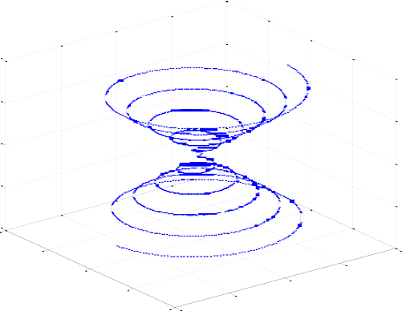
MATLAB lecture
Chapter Five: Graphics Assistant lecture: Jinan N. Shehab
>>syms x
>> y=x^3+7*x^2-5*x+4;
>> ezplot(y,[1:5])
>> yp=diff(y);
>> figure(2)
>> ezplot(yp,[1:5])
5.2 Three-Dimensional plot:-
MATLAB has a variety of functions for displaying and visualizing data in 3-D. either as lines in 3-D (plot3) , or as a wire frame (mesh) and surfaces (surf) .
5.2.1 Curves in Three-Dimensional Space
For plotting curves in 3-space, the basic command is plot3, and it works like plot, except that it takes three vectors instead of two, one for the x coordinates, one for the y coordinates, and one for the z coordinates.. The command:
Plot3(x,y,z)
Example:- write Script file graph to plot Curve r(t) = < t*cos(t), t*sin(t), t > , if you know the
𝝅
interval t=-10 to 10𝝅with steps.
Solution:-
���
Curve u(t) = < t*cos(t), t*sin(t), t >
t = -10*pi:pi/100:10*pi; x = t.*cos(t);
y = t.*sin(t);
plot3(x,y,t);
title('Curve u(t) = < t*cos(t), t*sin(t), t >') xlabel('x');ylabel('y'); zlabel('z')
grid on
5.2.2 Surfaces in Three-Dimensional Space:-
40
20
z
0
-20
-40
40
20
40
0
-20
-20
0
20
y
-40
-40
x
There are two basic commands for plotting surfaces in 3-space: mesh and surf. There are two different ways of using each command, one for plotting surfaces in which the z coordinate is given as a function of x and y, and one for parametric surfaces in which x, y, and z are all given as functions of two other parameters.
>> mesh(X,Y,Z)

Slide 9
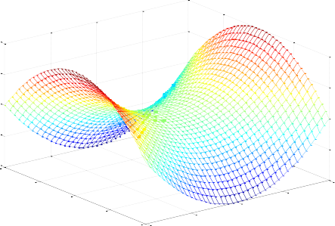
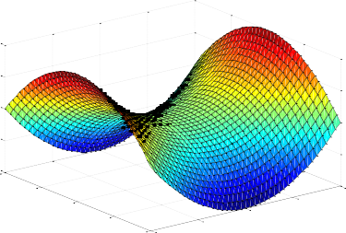
MATLAB lecture Chapter Five: Graphics
Assistant lecture: Jinan N. Shehab
Example:-plot the surface Z=x²-y²? Solution
>>[X,Y] = meshgrid(-2:.1:2, -2:.1:2);
>> Z = X.^2 - Y.^2;
>> mesh(X, Y, Z)
4
2
0
-2
-4
2
1
2
0
-1
-2 -2
-1
0
1
Example:-
t = 0:pi/10:2*pi;
[X,Y,Z] = cylinder(4*cos(t)); subplot(2,2,1); mesh(X); title('X');
subplot(2,2,2); mesh(Y); title('Y');
subplot(2,2,3); mesh(Z); title('Z');
% repeat this example for command surf
subplot(2,2,4); mesh(X,Y,Z); title('X,Y,Z');
A surface plot is similar to a mesh plot except the rectangular faces of the surface are colored. Example:-plot the surface Z=x²-y²?
>> [X,Y] = meshgrid(-2:.1:2, -2:.1:2);
>> Z = X.^2 - Y.^2;
>> surf(X, Y, Z)
4
2
0
-2
-4
2
1
0
1
2
-1
-1
0
Example:- If r denotes the distance to the z axis, then the equation⁻² of the sphere becomes
-2
r²+ z² = 1, or r=√� − ��,so x =√� − �� ���𝜽, � = √� − �� �𝒊�𝜽, plot this surface. Solution:-
[theta, Z] = meshgrid((0:0.1:2)*pi, (-1:0.1:1)); X = sqrt(1 - Z.^2).*cos(theta);
>> Y = sqrt(1 - Z.^2).*sin(theta); surf(X, Y, Z); axis square figure(2)
mesh(X,Y,Z); axis square

